Slide 1
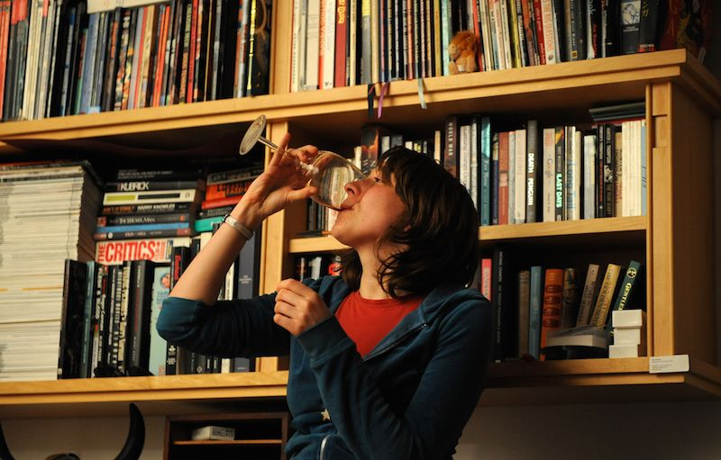
Wild Wisconsin Winter Web Conference
Librarians and Bartenders: Why People Need Us
Carolyn Brewer, January 2018

Slide 2
The day in the life of a librarian:
Librarians help people escape………whenever they need it.

Slide 3
The day in the life of a librarian:
We serve them for our employment….and maybe an occasional cake!

Slide 4
The day in the life of a librarian:
Librarians get to hear many complaints, issues and heartbreak.

Slide 5
The day in the life of a librarian:
Hear fun stories, sweet stories, triumphs, meet family, etc…..( um…and also blooming relationships.)

Slide 6
The day in the life of a bartender:
Bartenders help people escape……..whenever they need it.

Slide 7
The day in the life of a bartender:
Tips are expected for a bartender.

Slide 8
The day in the life of a bartender:
Bartenders get to hear everyone’s complaints, issues and heartbreak.

Slide 9
The day in the life of a bartender:
Bartenders get to enjoy celebrations, parties and blooming relationships.

Slide 10
I LOVE my job!!
There are good days and bad days – right?

Slide 11
BE INSPIRED!
BE HELPFUL
BE ADAPTABLE

Slide 12
What Else “TO BE?”
Let’s Chat About it…………….

Slide 13
Keep a File of Kudos and Big Wows Life Changing Moments The Human Stories

Slide 14
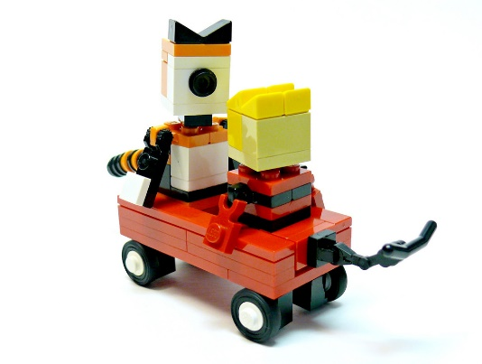
The Wisdom of Calvin and Hobbes!
Calvin: In my opinion, we don’t devote nearly enough scientific research to finding a cure for jerks.
Calvin: People think it must be fun to be a super genius, but they don’t realize how hard it is to put up with all the idiots in the world.

Slide 15
How to Stay Encouraged in Difficult Moments Do you have any suggestions to share in Chat?

Slide 16
Closing the Bar…..
The Last Customers of the Night
Until Tomorrow

Slide 17
Questions/Comments
Carolyn Brewer
Carolyn.brewer@tccd.edu

