Slide 1
Developing Dynamic Leadership for your Library
Gavin J. Woltjer, Library Director, Billings Public Library

Slide 2
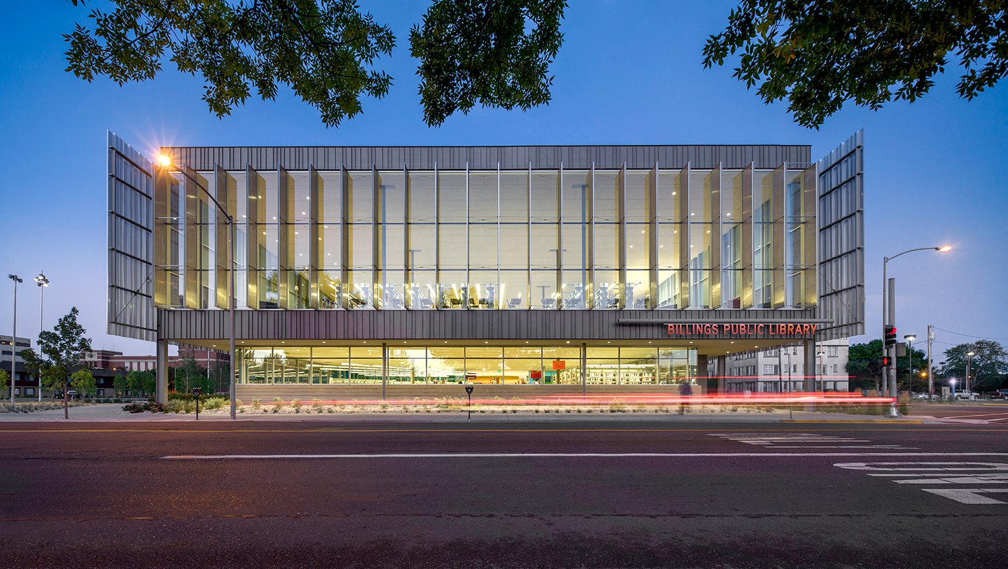

Slide 3
Overview of Presentation:
1. Accountability and Expectations
2. Failure
3. Initiative and Creativity
4. Library Narrative
5. Communication

Slide 4
Takeaways:
Begin the process of articulating a leadership strategy…
Begin the process of creating a narrative of leadership within your Library…
Begin the process of identifying your own strengths and weaknesses to grow as a leader…

Slide 6
Accountability and Expectations

Slide 7
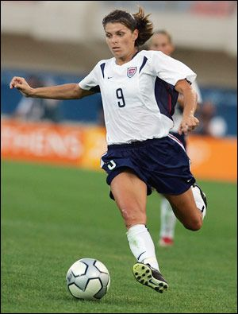
I am a member of a team, and I rely on the team, I defer to it and sacrifice for it, because the team, not the individual, is the ultimate champion.
--Mia Hamm

Slide 8
1. Have you shared your expectations with your staff?
2. Have you asked your staff what their expectations for you are?
(Board, Foundation, FOL, Public Stakeholders, Elected Officials, Partnerships…)

Slide 9
Leadership = face of the organization/department
Customer Service
External
Internal
How you serve your staff directly influences the level of accountability and expectations you can demand…

Slide 10
Failure

Slide 11
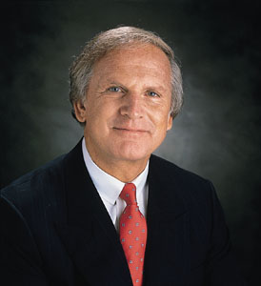
Failure should be our teacher, not our undertaker. Failure is delay, not defeat. It is a temporary detour, not a dead end. Failure is something we can avoid only by saying nothing, doing nothing, and being nothing.
--Denis Waitley

Slide 12
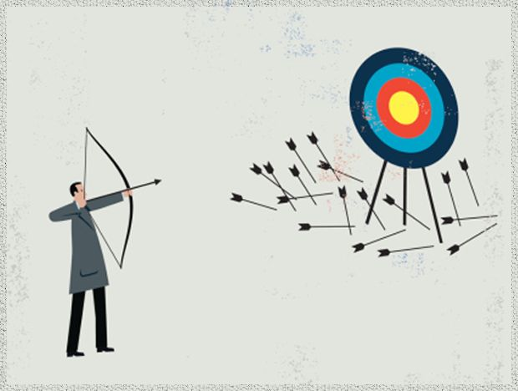
ABJECT FAILURE:
CVP FAILURE:
Catastrophic
Unrecoverable
Permanently Damaging
Permanent Loss
Common
Version (Evolved)
Predicted
Constructive
Strategic
Methodical/Intentional

Slide 13
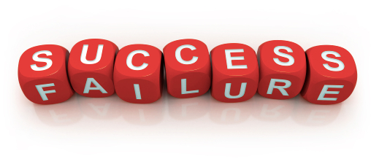
Learn from failure – individually and collectively
Identify the components that failed – STUDY THEM!
Make adjustments and try again.
Repeat the process.

Slide 14
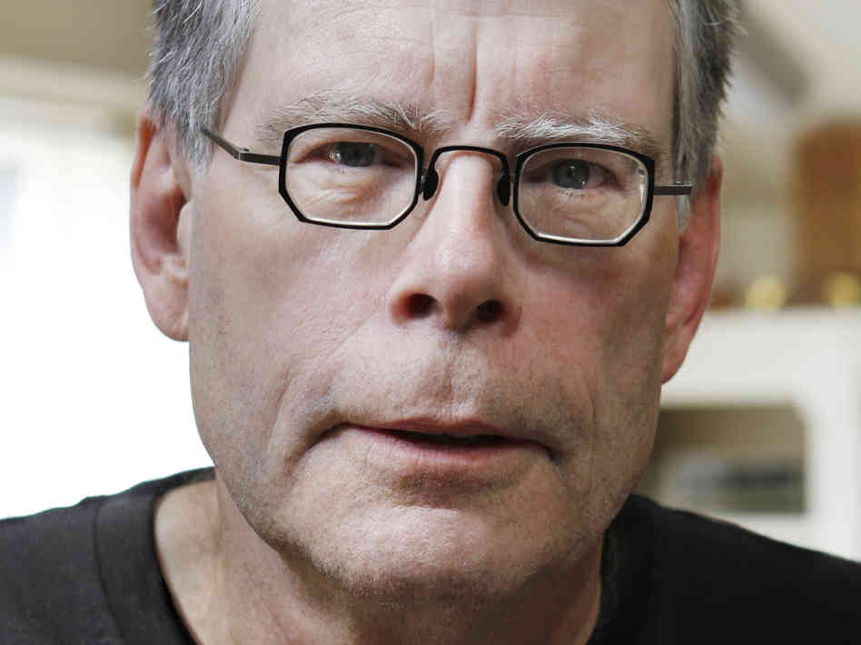

Slide 15
Initiative and Creativity

Slide 16
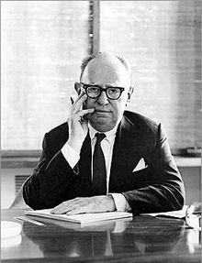
Curiosity about life in all of its aspects, I think, is still the secret of great creative people. --Leo Burnett

Slide 17
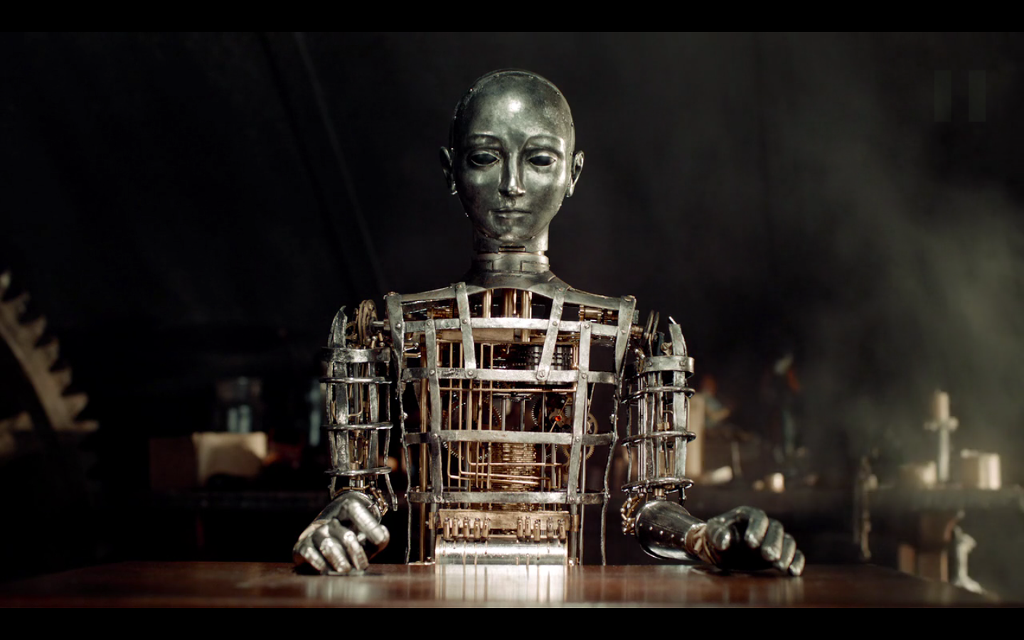

Slide 18
Feed the drive…
Challenge new perspective…
Be part of the TEAM…
Silence is Golden…
Build up…
Overly critical…
“My way or the highway…”
On the outside looking in…
More talking than listening…
Tear down…

Slide 20
Library Narrative & Communication

Slide 21
“And on the subject of burning books: I want to congratulate librarians, not famous for their physical strength or their powerful political connections or their great wealth, who, all over this country, have staunchly resisted anti-democratic bullies who have tried to remove certain books from their shelves, and have refused to reveal to thought police the names of persons who have checked out those titles. So the America I loved still exists, if not in the White House or the Supreme Court or the Senate or the House of Representatives or the media. The America I love still exists at the front desks of our public libraries.” --Kurt Vonnegut

Slide 22
Creating a Library Narrative…
Who are you as a Leader?
What is the identity of your community?
What are the needs of your community?
What is the expertise of your staff?
Short-term vs. Long-term…
Financials…
Who has input?

Slide 23
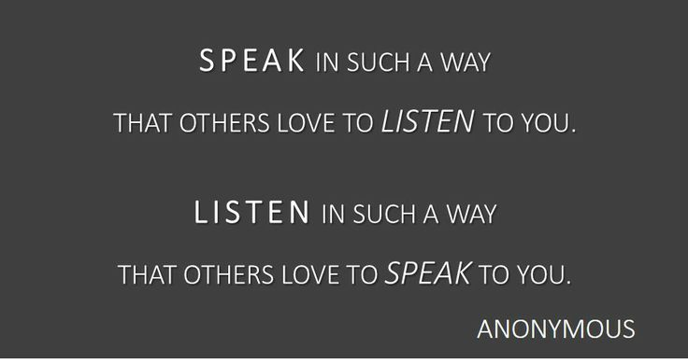
Clear. Complete. Concise.
When not to communicate…
Be available…
Solve problems, don’t be part of them…
Give examples…
Be consistent!
Understand each personality…
Create the environment…

Slide 24
My 3 Rules… 1. Take care of self… 2. Take care of family… 3. Honor of the culture of respect…

Slide 25
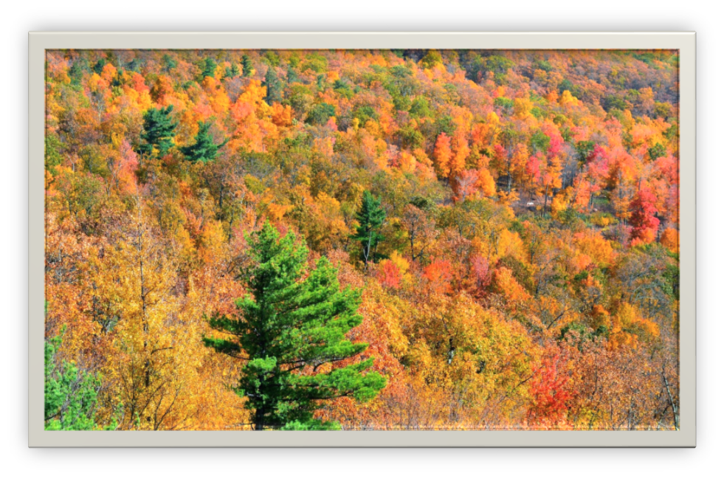
Be Bold. Be Innovative. Be fearless. Change is inevitable…
“Change will not come if we wait for some other person or some other time. We are the ones we’ve been waiting for. We are the change that we seek.”
– Barack Obama

