Slide 1
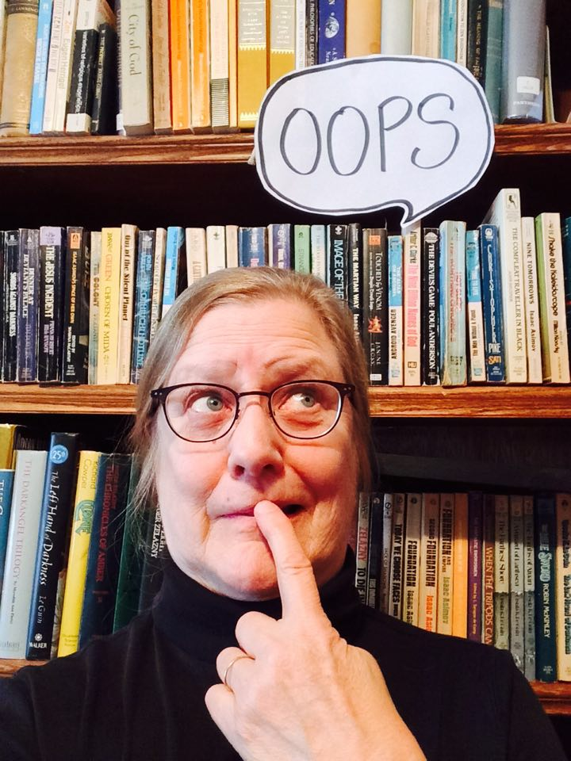
My 10 Biggest Mistakes - and How to Avoid Them Marge Loch-Wouters

Slide 2
Looking Back
Perfection? Ha!
Mistakes as Learning Tools

Slide 3
1 Everybody Does Deadlines Like I Do Deadlines

Slide 4
2 I Wanna Be Your Friend

Slide 5
3 I’m Busy, Don’t Bother Me!

Slide 6
4 Fight Every Battle

Slide 7
5 Let Me Just Tell You Exactly What I Think

Slide 8
6 Do ALL. THE. THINGS.

Slide 9
7 Seriously? You Can’t Read My Mind?

Slide 10
8 Why Can’t Everybody Get on the Bus?

Slide 11
9 Work Harder – It Solves Everything

Slide 12
10 Failure is Failure

Slide 13
Lessons Learned?
Stress
Self Awareness
Self Care

Slide 14
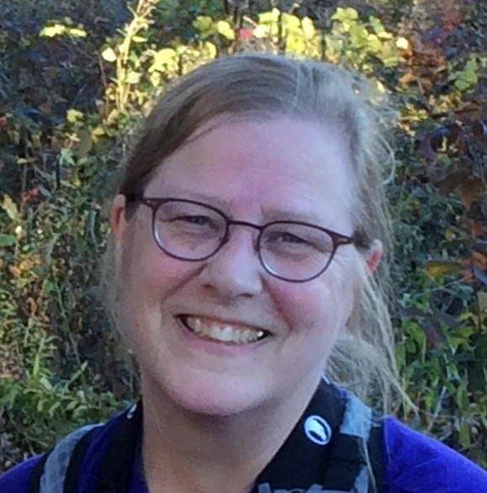
Thank You!
Marge Loch-Wouters
Loch-Works Consulting lochwouters@gmail.com

